Slide 1
Titanic Survival Prediction

Slide 2
Internship Project From Neuro Nexus Innovation
Done By : Md Rian Ur Rahaman

Slide 3
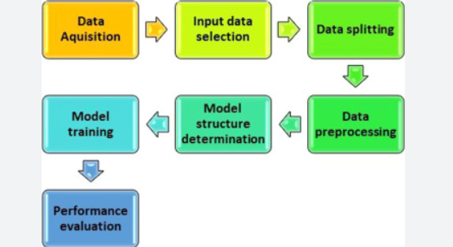
Architecture Diagram

Slide 4
Requirements Libraries and Packages
1. Numpy.
2. Pandas
3. Matplotlib
4. Seaborn
5. Ipykernel
6. Scikit-Learn

Slide 5
Data Collection
Dataset Collected From Kaggle Dataset
I read the dataset using Pandas library.

Slide 6
Data Preprocessing and EDA
After reading the training dataset I start the data preprocessing . Few Steps are in the below .
Handling Missing Data:
Identify missing values in the dataset. Decide whether to drop missing values, fill them with a specific value or use more advanced imputation techniques.
EDA Performing.
Feature Engineering:
Create new features that might be more informative for the model.
Combine or transform existing features.

Slide 7
Train Test Split and Model Selection
After The Preprocessing the data divided into train test split which helps to find accuracy on the training data and test data
Then , The Logistic Regression Model is selected and trained over the train test split dataset .
Accuracy on Train Data : 87%
Accuracy On Test Data : 78%

Slide 8
Prediction Web App
After saving the trained model using pickle I make a Predticion Web App .
The Titanic Survival Prediction Web App is made by using Flask .

Slide 9





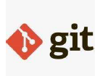
Tools Used

Slide 10
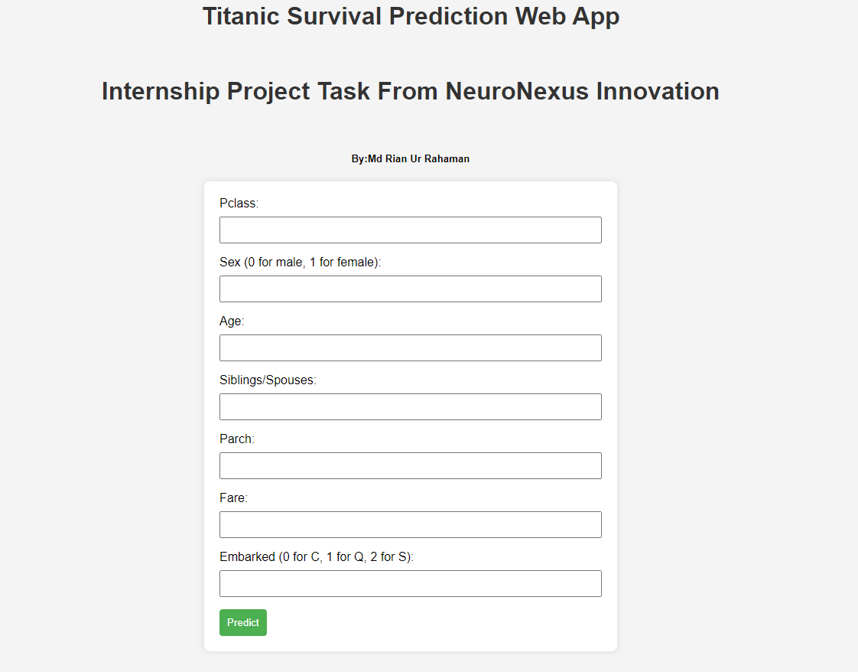
Web App Design

Slide 11
Conclusion
I use the logistic regression model which gives 80% accuracy on the training dataset and 78% on test dataset which is poor result . For further improvement we can various model .
Understanding the dataset and cleanup . Build a strong classification model to predict whether the passenger survives or not . Also Fine tune the hyper-parameters & evaluation metrices of various classification algorithms .

